Slide 1
Legacy of Nazism
Aftermath of WWII
Germany after Hitler
United Nations establishment
Nuremburg Trials and Nazi Hunters

Slide 2
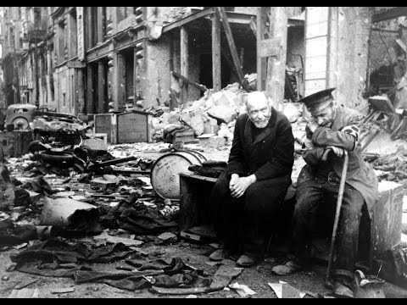
Aftermath of WW2
Germany had occupied much of Europe during World War II. Many of the countries in the west returned to the same governments and borders they had prior to the war. However, Germany was divided up into Eastern and Western Germany. The Eastern part was controlled by the USSR (Russia) and the Western part by the Allies.

Slide 3
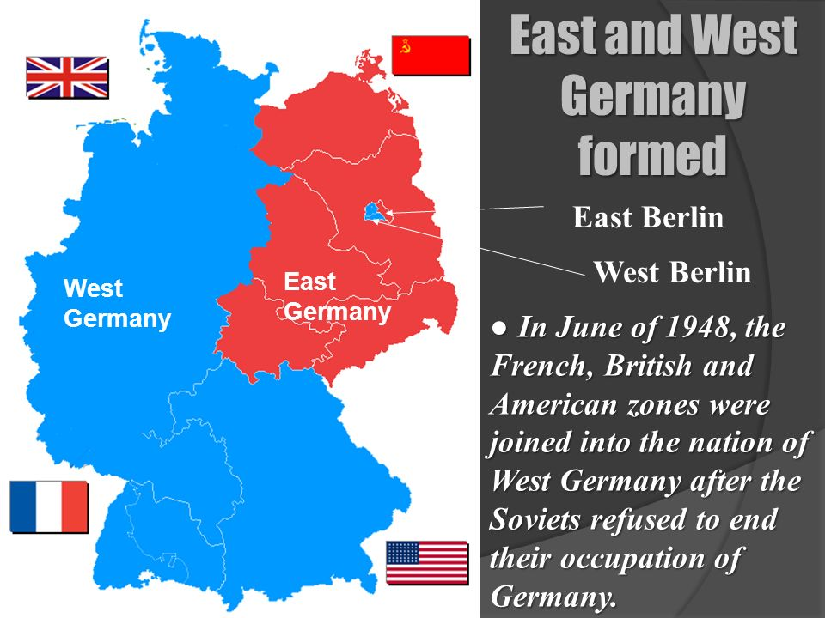

Slide 4
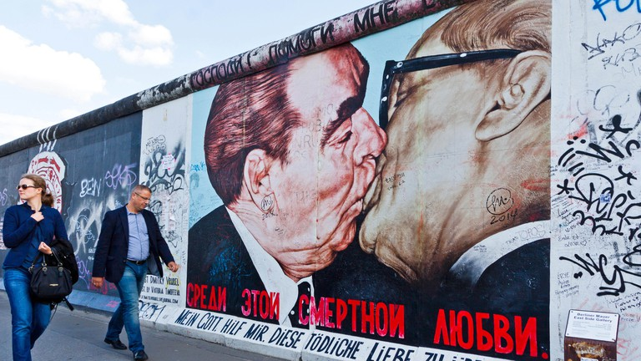
Berlin Wall
On August 13, 1961, the Communist government of the German Democratic Republic (GDR, or East Germany) began to build a barbed wire and concrete “Antifascistischer Schutzwall,” or “antifascist bulwark,” between East and West Berlin. The official purpose of this Berlin Wall was to keep Western “fascists” from entering East Germany and undermining the socialist state, but it primarily served the objective of stemming mass defections from East to West. The Berlin Wall stood until November 9, 1989.

Slide 5
Germany after Hitler - denazification
Allies rid German and Austrian society, culture, press, economy, judiciary, and politics of the National Socialist ideology (Nazism). It was carried out by removing those who had been Nazi Party or SS members from positions of power and influence and by disbanding or rendering impotent the organizations associated with Nazism.
Germany, much of Europe and Russia lay in ruins following Hitler's war, the most destructive conflict in the history of humanity, in which 54 million persons had perished – with more civilians killed than combatants – while another 60 million civilians had been uprooted from their homes or seen them destroyed.
The immediate post-war problem for the victorious Allies in Germany was coping with the eleven million displaced persons (DPs) now wandering around. This included people from all over Europe and Russia who had been slave laborers, military conscripts, prisoners of war, and concentration camp inmates, including about 100,000 Jews who had survived the Final Solution.
Upon regaining their health, many of the Jews returned home, trying in vain to locate family members. In some cases, they found former neighbors now inhabiting their homes and shops. The new occupants soon made it clear they wished the Jews had never returned. Elsewhere, particularly in Eastern Europe, people lashed out at the returning Jews and hundreds were killed. As a result, the displaced Jews headed back to Germany and took refuge in American DP Camps, while they considered leaving Europe altogether and relocating to the historic Jewish homeland in the Middle East, an epic saga that would eventually lead to the founding of Israel.

Slide 6
“The most horrible crime ever committed in the whole history of the world”
How do we ensure this never happens again?

Slide 7
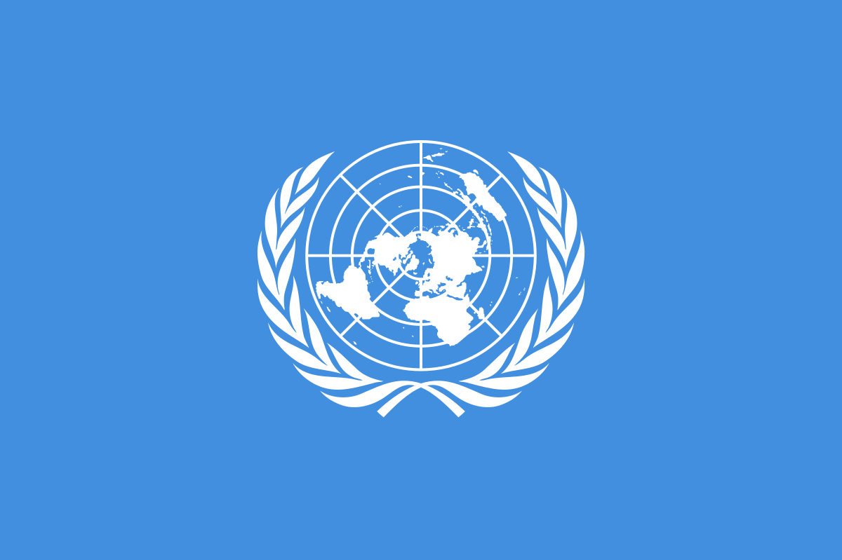

Slide 8

The United Nations (UN)
Tasked to promote international co-operation.
It was created as a replacement for the ineffective League of Nations.
The UN was established on 24 October 1945 after World War II with the aim of preventing another such conflict.
Universal Declaration of Human Rights (1948)

Slide 9
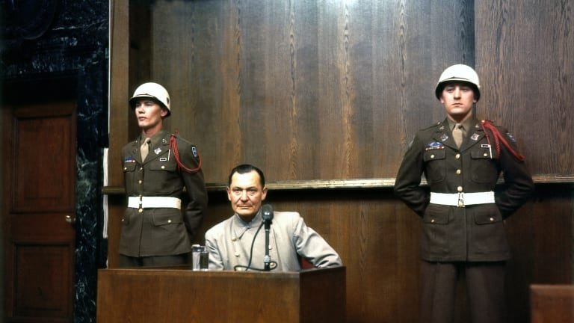
The Nuremburg war crimes trials
When the war was over the Allies put leading Nazis on trial.
Hitler and several other high ranking Nazis had already committed suicide.
Ribbentrop (Hitler’s Foreign Minister), Rosenberg (Minister for Occupied Territories), Goering (Commander of the Luftwaffe, Economics Minister) all condemned to death…although Goering committed suicide the day before he was to be hanged.
Adolf Eichmann, who played a leading role in the Holocaust, was captured by Israeli agents in Argentina in 1960, was tried in Israel and hanged in 1962.
Nazi Hunters were tasked with finding leading Nazis.

